Slide 1
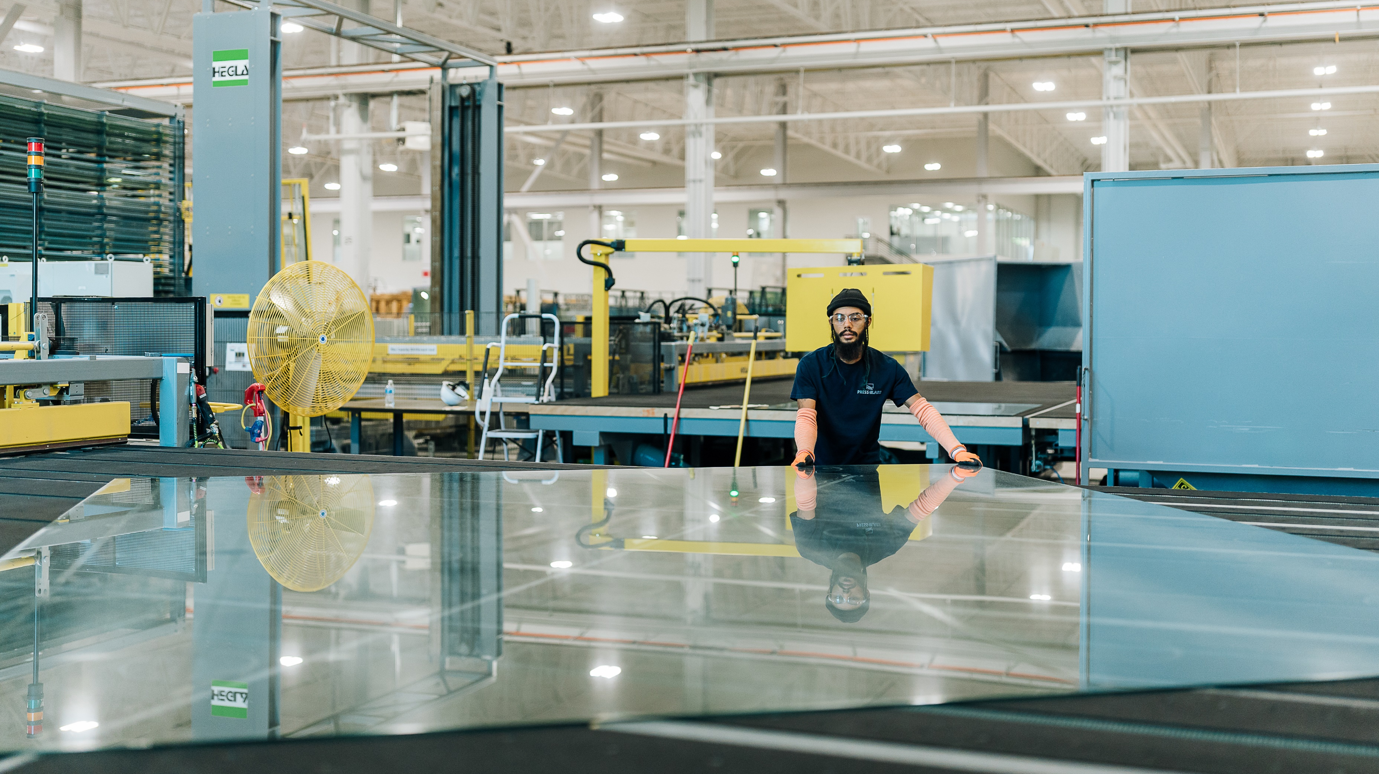

NEW in 2026:
April 26-29, 2026
Radisson Blu Aqua Hotel,
Chicago

Slide 2
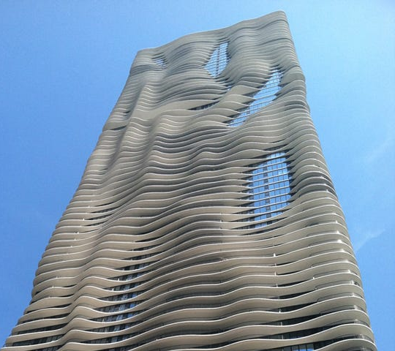
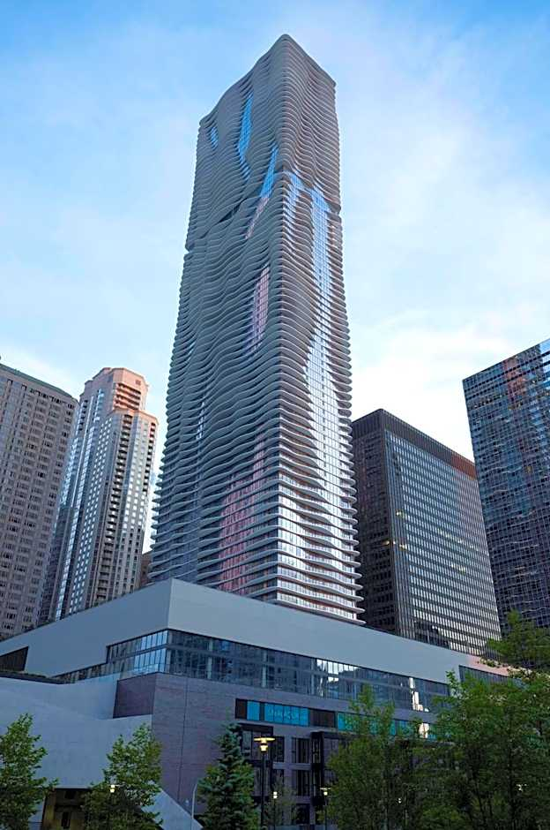
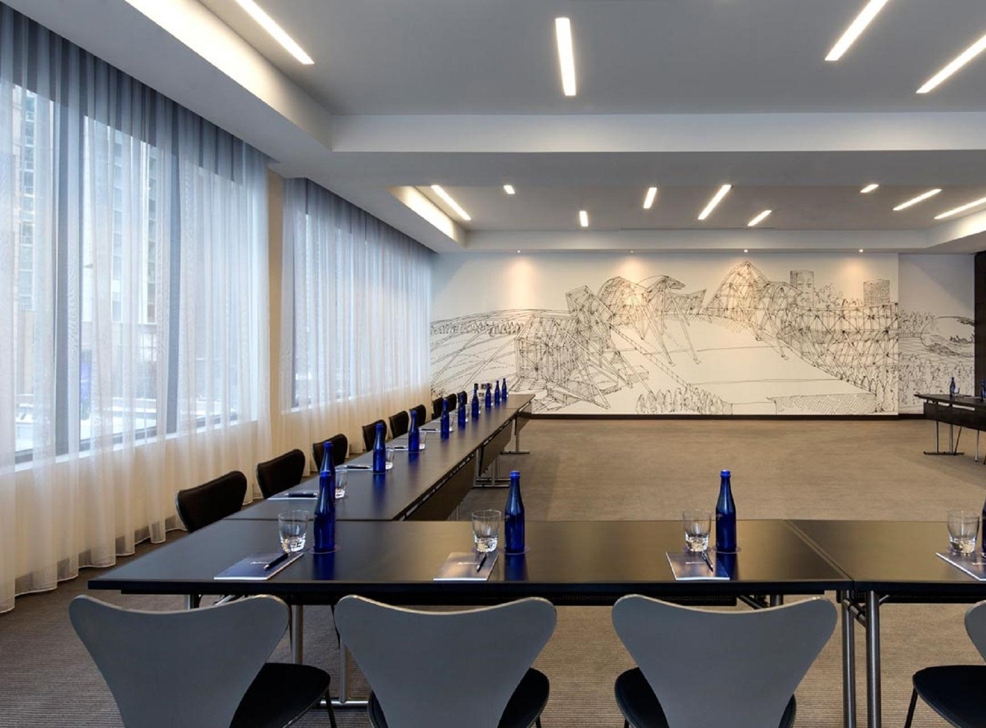
GFAB Radisson Blu Chicago

Slide 3
GFAB
Event Goals
Create a new event that builds on the strengths of NGA’s existing fabricator conferences (NGA Glass Conference and GPAD), with higher attendance and more fabricators of all sizes
Draw Executives, Technical Leaders, and Production Personnel for in-person education
Create 1:1 direct networking between fabricators and their key suppliers
Elevate NGA advocacy and technical activities

Slide 4
GFAB
NGA’s Strategic Goals
Educate
GFAB’s program is being designed to help glass fabricators build stronger, safer, more profitable companies.
Advocate
NGA’s essential advocacy and technical work continues at GFAB.
Workforce Development
NGA introduces in-person, hands-on learning at GFAB.

Slide 5
GFAB
Event Overview
GFAB will replace NGA Glass Conference held in the winter
If you are at NGA Glass Conference, you belong at GFAB
So, we will see you April 26-29, 2026
Radisson Blu Aqua Hotel, Chicago

Slide 6
GFAB
Event Overview
You belong at GFAB, if:
You are a glass fabricator
You are a supplier partner
You are an executive/decision maker
You are a glass industry technical, engineering leader
You are on the glass plant production floor (manager, quality control, maintenance, etc.)

Slide 7
GFAB
Event Overview
  Three Tracks for Targeted Education and Programming
  Executive Track
  Technical Track
  (NGA Glass Conference Track)
  Workshop Track

Slide 8
GFAB
Executive Track
  High-level, industry-specific programming for execs, VPs, strategic leaders
  Space is limited
  Construction forecast, economic updates
  Eye on technology and automation
  Glass design and market trends
  State of the glass industry
  Building your workforce
  Speakers will include: experts in manufacturing, construction economists, high-profile architects, leaders in recruitment and workforce development, and more
  Targeted networking opportunities for executives

Slide 9
GFAB
Technical Track
  More traditional NGA Glass Conference programming for Committee volunteers, glass technical leaders, suppliers, and more.
  Meetings for NGA’s Fabricating, Forming and Advocacy Committees
  Updates on code, standard, and regulatory changes that will impact your companies
  Technical discussions about key glass fabrication issues
  Presentations about advancements in fabrication technologies, processes

Slide 10
GFAB
Workshop Track
  Tempering workshop and production-focused education for plant personnel. Offsite, at Skyline Design’s Chicago fabrication facility.
  Space is limited.
  Focus on glass tempering—common challenges, best practices, quality control, etc.
  Interactive, hands-on learning in an in-person factory environment
  Valuable production-focused educational programming for attendees
  Education on equipment advancements and automation solutions, quality control tools, maintenance considerations, and more
  Content to help fabricators improve quality, increase profits and productivity, reduce rejects and downtime

Slide 11
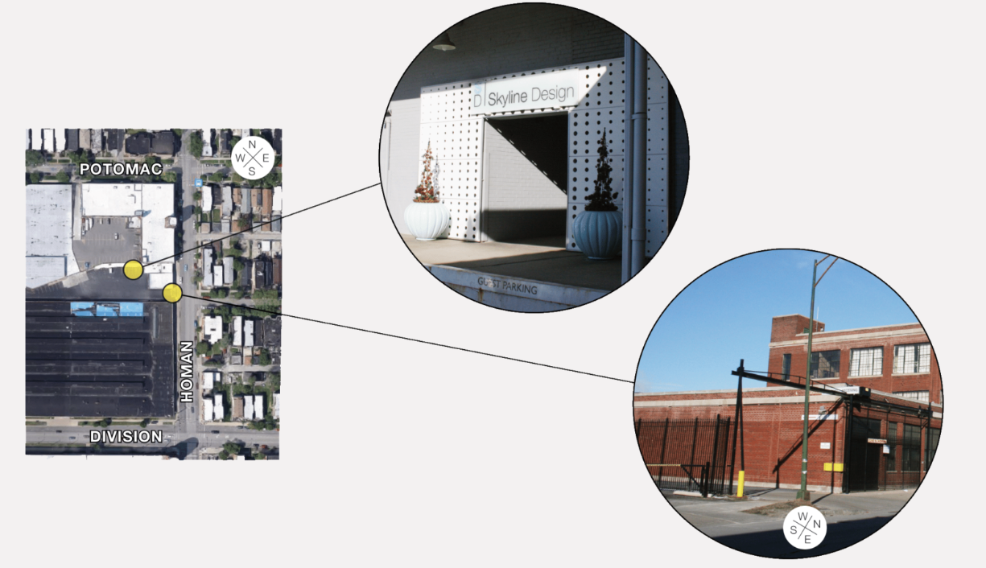
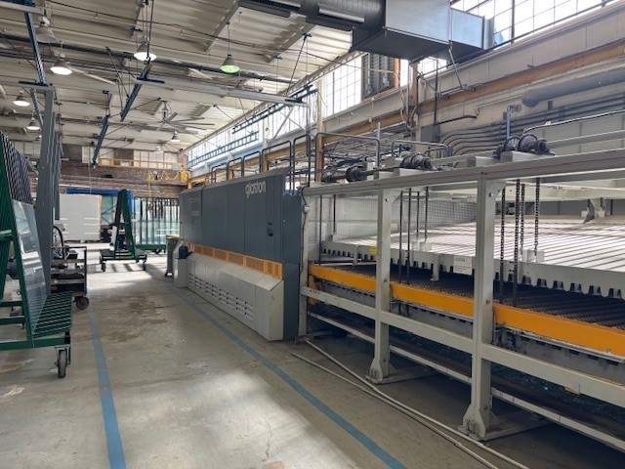
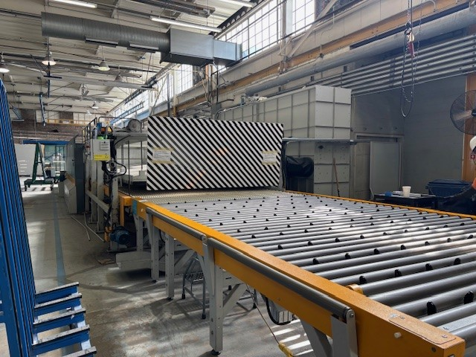
GFAB Skyline Design

Slide 12
GFAB
Program for All Attendees
  GFAB will bring together attendees from all tracks for numerous conference-wide networking opportunities and events.
  GFAB Lab - Networking area, with hands-on activities, table-top exhibits and interactive games/contests
  Glass factory tour
  Fun run/walk
  NGA Volunteer Award reception and dinner
  Off-site networking
  Conference breakfast, lunch

Slide 13
Sunday, April 26 | Monday, April 27 | Tuesday, April 28 | Wednesday, April 29
Executive Track Program
All Attendees
GFAB Lab – Tabletop networking interactive zone
Technical Track
Program
All Attendees
GFAB Lab – Tabletop networking interactive zone
Workshop
Track
(offsite – Skyline Design)
Technical Track
Program
All Attendees
Glass Factory Tour (offsite - Skyline)
Executive Track Welcome Reception
All Attendees
NGA Award Reception and Dinner
All Attendees
Networking Event (offsite)
*Schedule outline as of Sept. 2025. Subject to change.

Slide 14
GFAB
FAQs
Is GPAD still happening?
What about the winter NGA Glass Conference?
No. GFAB will replace GPAD and the winter NGA Glass Conference, bringing together the strengths of these two events while adding additional education, programming and networking opportunities that stakeholders have been seeking.
In other words:
See you in Chicago, April 26-29

Slide 15
GFAB
FAQs
Can I attend more than one Track?
It depends.
Executive Track + Technical Track
– YES (space is limited for Executive Track)
Executive Track + Workshop Track
– YES (space is limited for both tracks)
Technical Track + Workshop Track
– MAYBE. Committee work will be ongoing during the Workshop Track. We strongly encourage companies to send plant personnel to the Workshop.

Slide 16
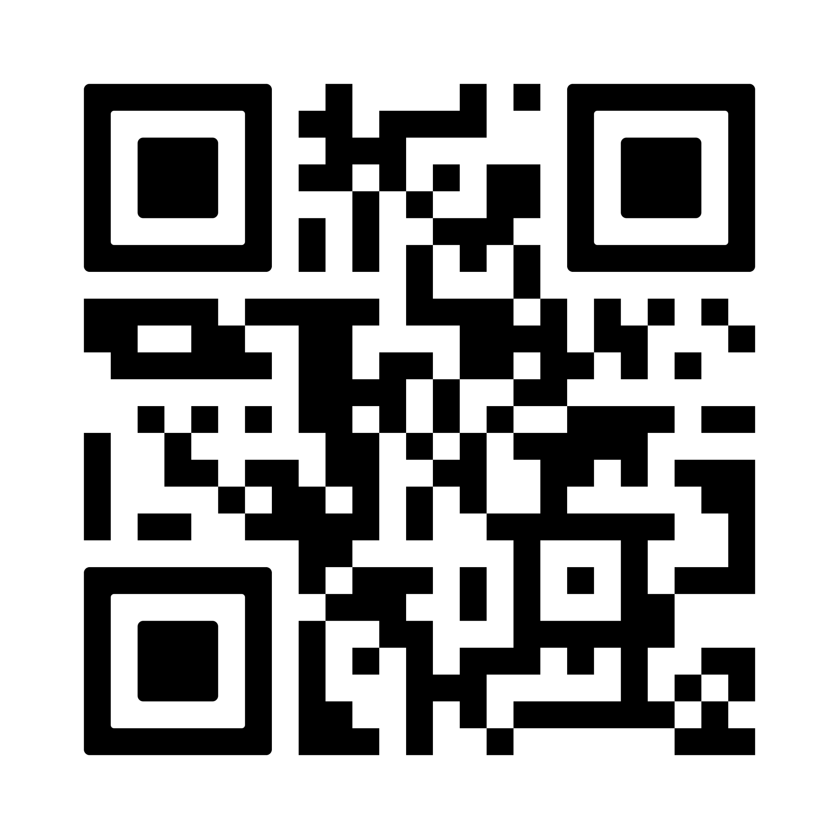
GFAB
FAQs
Are you looking for sponsorships?
Yes!
Scan the QR code to check out the Sponsorship Prospectus

Slide 17
NEW in 2026:
April 26-29, 2026
Radisson Blu Aqua Hotel,
Chicago

